Slide 1

Human Resources Analysis
Group 1: Xing Fang, Yating Liu
Advisor: Professor David Belanger

Slide 2
1
Problem
IBM HR Analytics Employee Attrition & Performance
Predict attrition of your valuable employees

Slide 3
2
Data
Data Source:
https://www.kaggle.com/pavansubhasht/ibm-hr-analytics-attrition-dataset
Data Size: The dataset contains 1470 rows of 35 variables.

Slide 4
Data Visualization
Yes
No

Slide 5
Data Visualization
Yes
No

Slide 6
Preparation
Data
E.G.
Attrition: Yes-2, No-1
Business Travel: Travel-Rarely-3, Travel-Frequently-2, Non-Travel-1
Department:Sales-3, Research & Development-2, Human Resources-1
Datatype Transformation
Check Missing Values
Data Balance – “upsample”
Zero-Variance Variables Removing

Slide 7
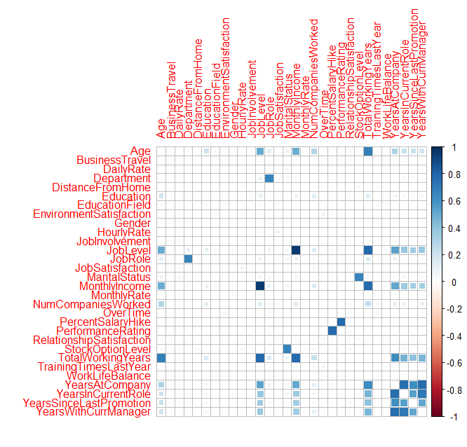
Exploratory Data Analysis
Identify zero-variance columns (Over18 and StandardHours), then remove them.
Correlation matrix
Age – TotalWorkingYears
TotalWorkingYears – MonthlyIncome
YearsWithCurrManager – YearsAtCompany
MonthlyIncome - JobLevel

Slide 8
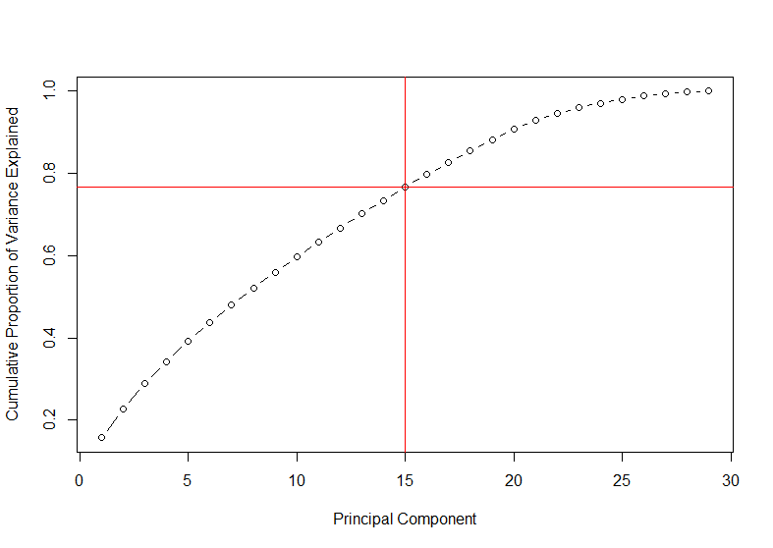
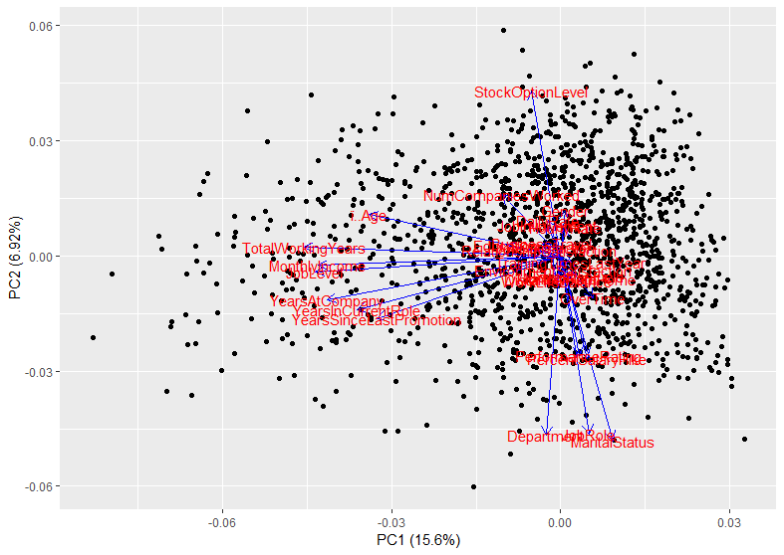
PCA
3
Dimension Reduction
Data Normalization
normalize <- function(x) {return ((x - min(x)) / (max(x) - min(x)))}
(15, 0.76)

Slide 9
4
Classification
Linear Discriminant Analysis
Logistic Regression Analysis
K-nearest Neighbors Algorithm
Random Forest Analysis
K-fold Cross-Validation: 10-fold cross validation to estimate the prediction error

Slide 10
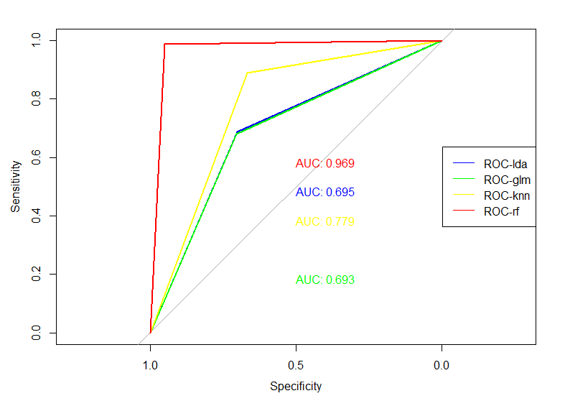
4 methods of classification in the whole data
lda: 0.695 glm: 0.693
knn: 0.779 rf: 0.969
Logistic Regression Model
gets the highest accuracy and AUC of the whole data.

Slide 11
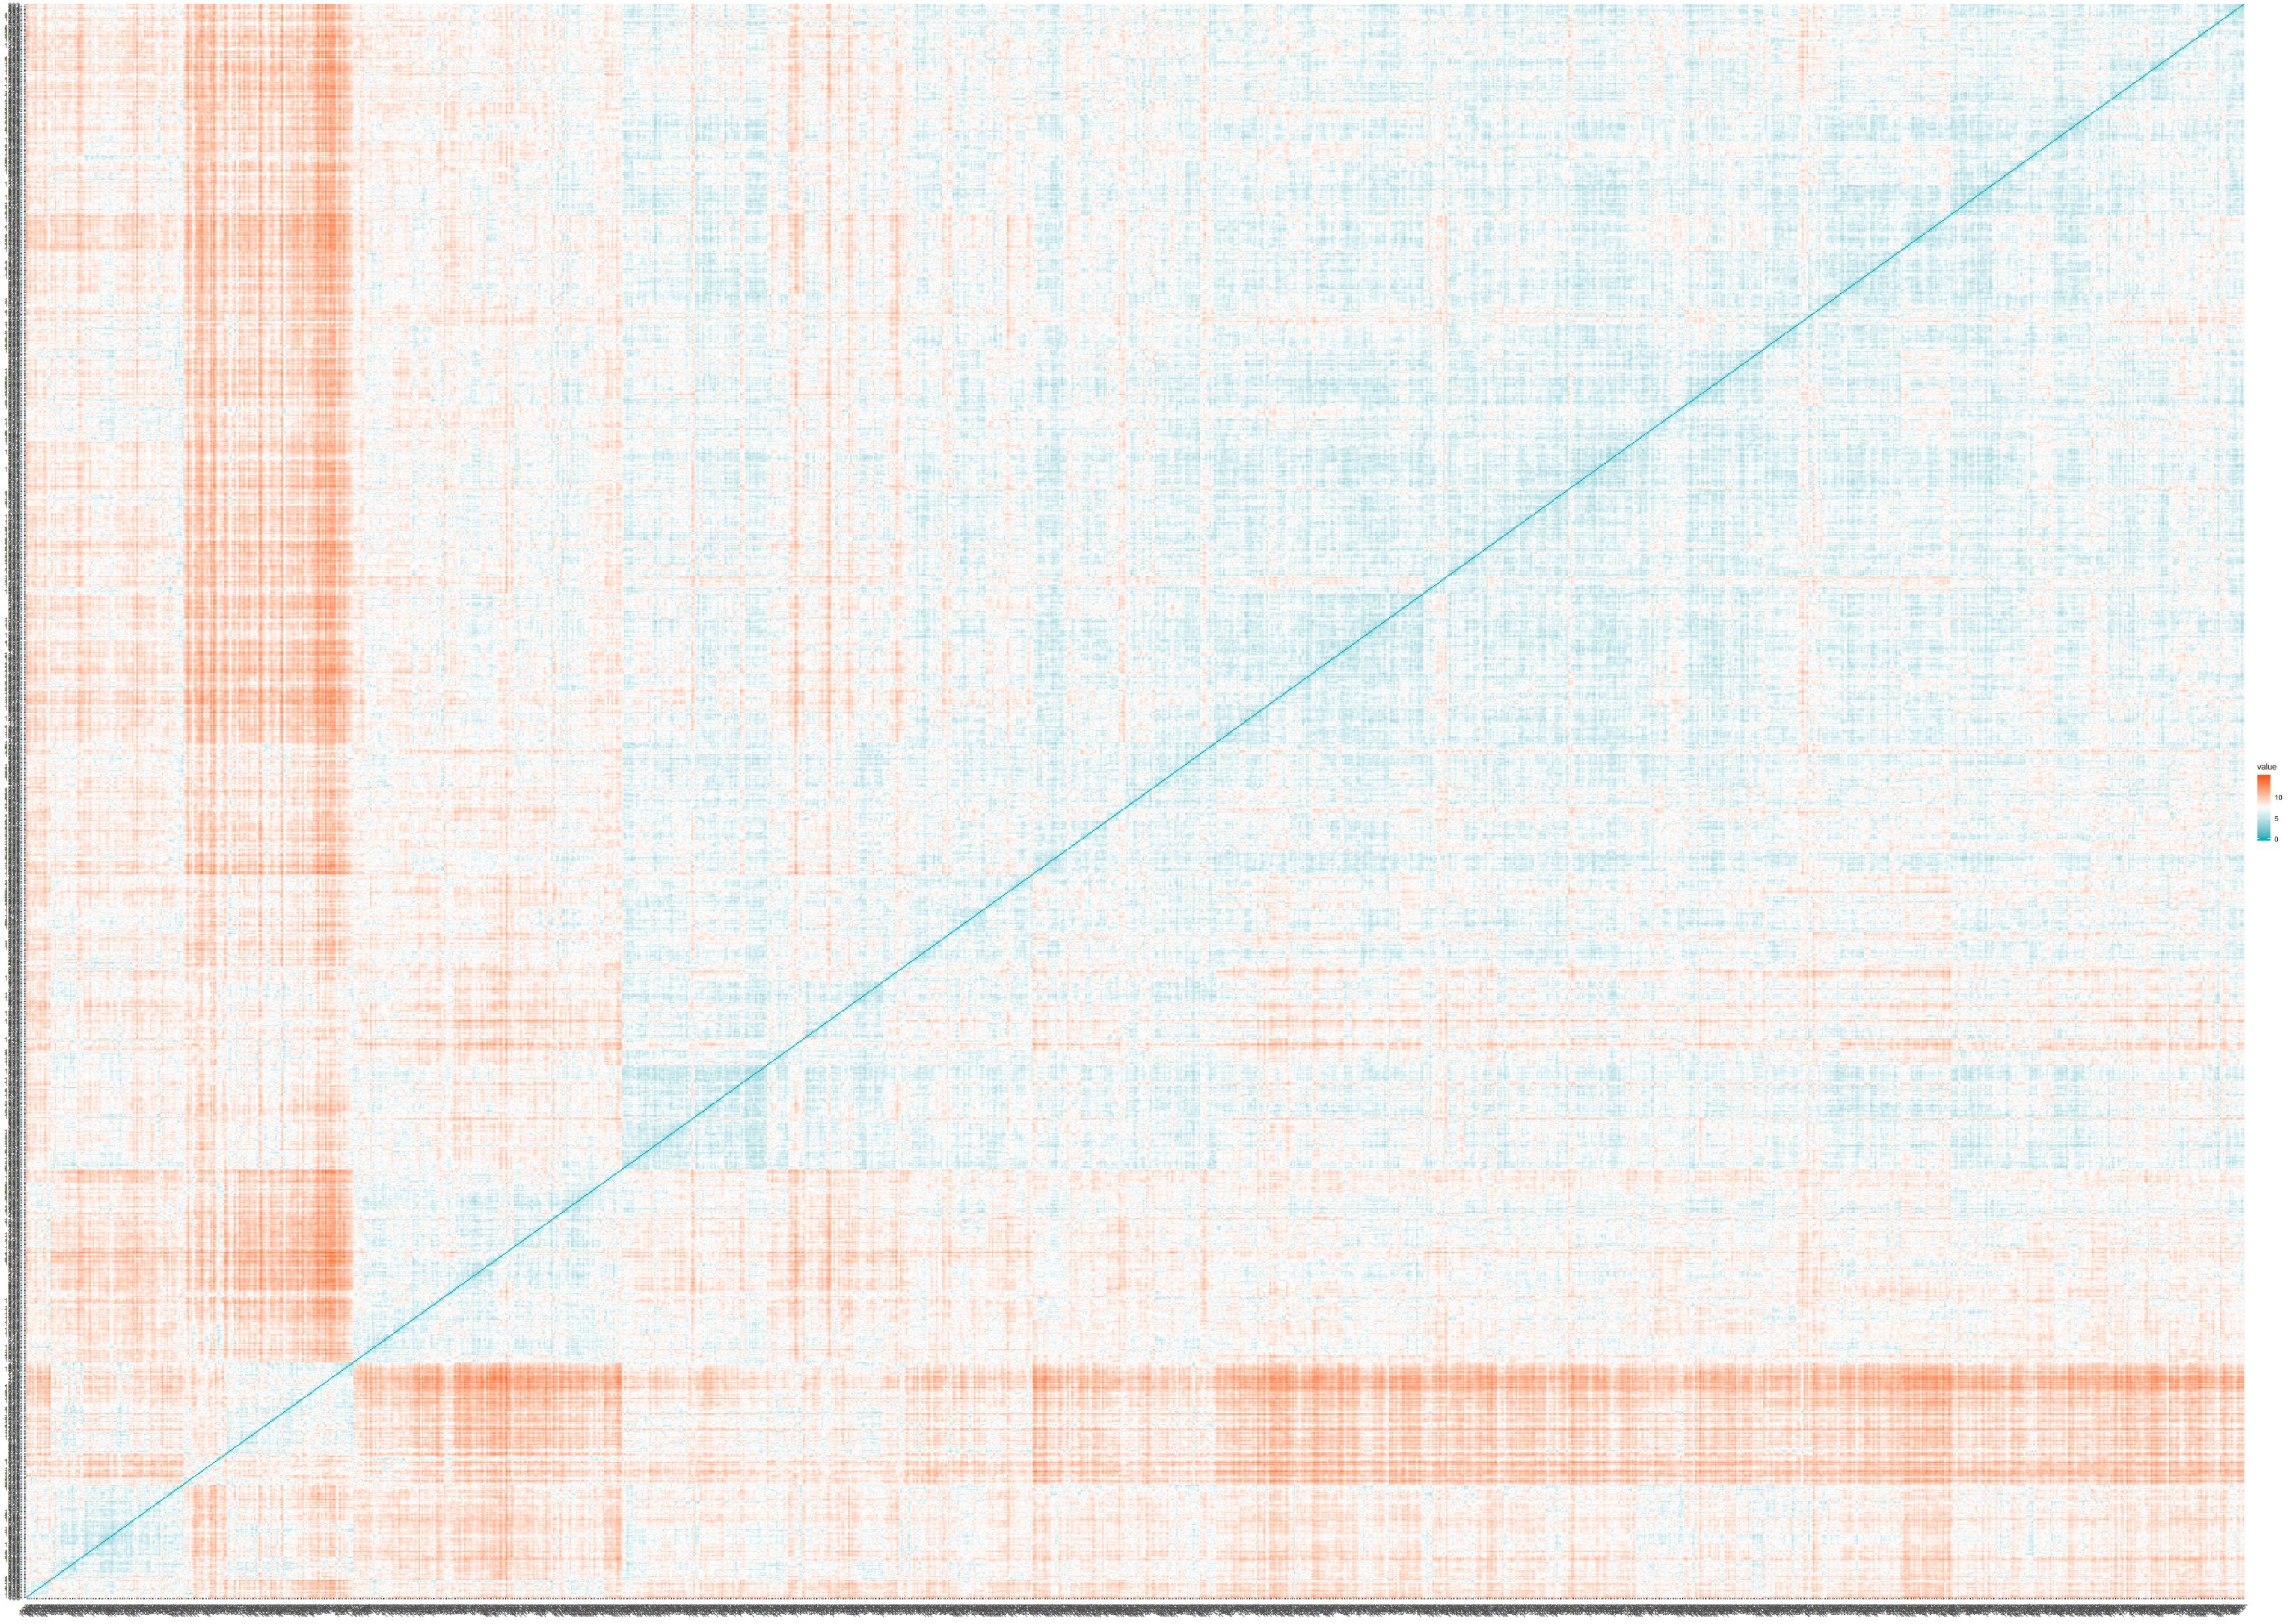
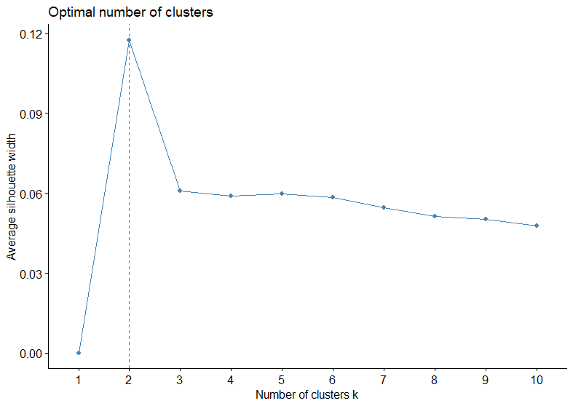
Clustering
K-means clustering
5
Distance Matrix
Method: silhouette

Slide 12
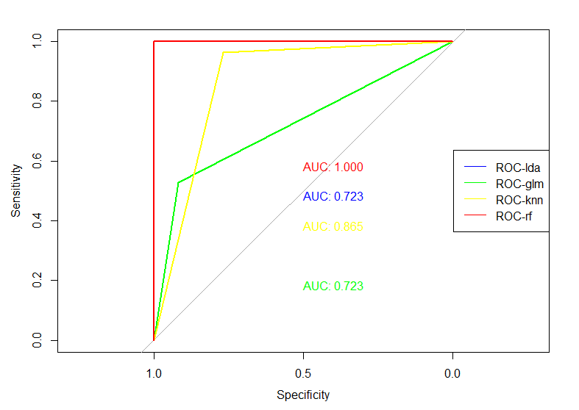
Classification
in 1st cluster
6
Cluster1: 691 rows
lda: 0.723 glm: 0.723
knn: 0.865 rf: 1

Slide 13
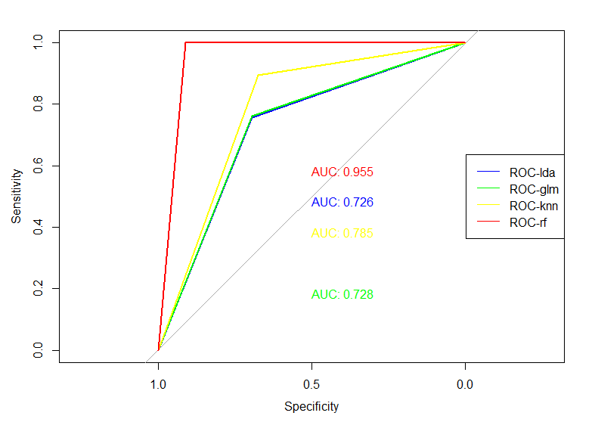
Classification
in 2nd cluster
Cluster2: 1775 rows
lda: 0.726 glm: 0.728
knn: 0.785 rf: 0.955

Slide 14
Conclusion
After clustering, most models improve accuracy.
After clustering, most models improve AUC.
Attrition
Accuracy
 | lda | glm | knn | rf
Whole Data | 0.6943 | 0.6923 | 0.7834 | 0.9696
Cluster-1 | 0.7698 | 0.7698 | 0.8417 | 1
Cluster-2 | 0.7296 | 0.7324 | 0.7972 | 0.9606
AUC
 | lda | glm | knn | rf
Whole Data | 0.695 | 0.693 | 0.779 | 0.969
Cluster-1 | 0.723 | 0.723 | 0.865 | 1
Cluster-2 | 0.713 | 0.72 | 0.762 | 0.972
Cluster analysis can’t play very good results on supervised data, but can improve the accuracy of data analysis to some extent.

Slide 15
Conclusion
Cluster analysis can improve the accuracy of data analysis in human resources area. So even if cluster analysis is mainly used for unsupervised data, sometimes it can also work on supervised data.
By comparing four models, we found that no matter in which cluster, or in AUC/accuracy, Random Forest Analysis is always the best model.
To make our data balanced, we tried “upsample” and “downsample” two methods. After all, data after “upsample” has better performance than “downsample”.
Attrition

Slide 16
THANKS

